Slide 1

Big Data Project
Dawit Woldegiorgis
Omar AbdeltwaB

Slide 2




In-Mapper Wordcount

Slide 3
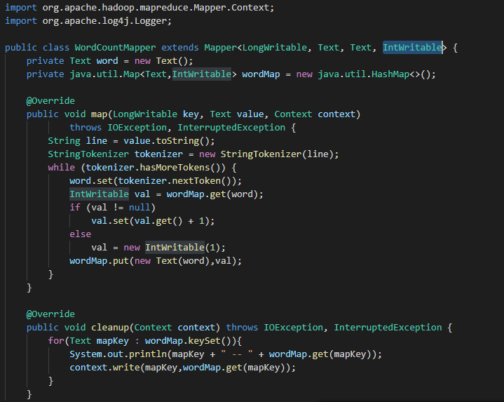
In-Mapper Wordcount Mapper

Slide 4
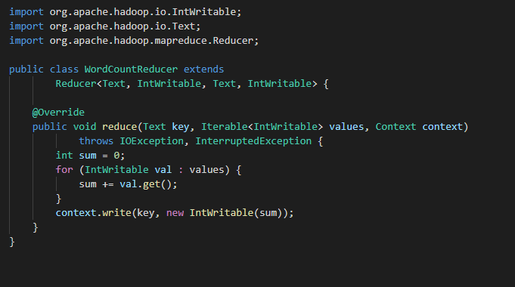
In-Mapper Wordcount Reducer

Slide 5
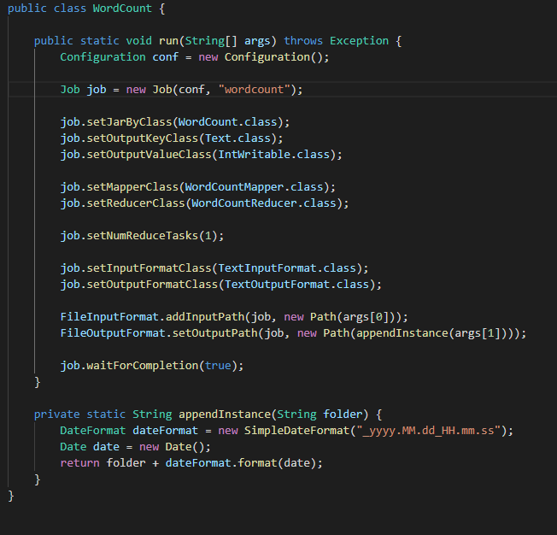
In-Mapper Wordcount Main

Slide 6
Average

Slide 7
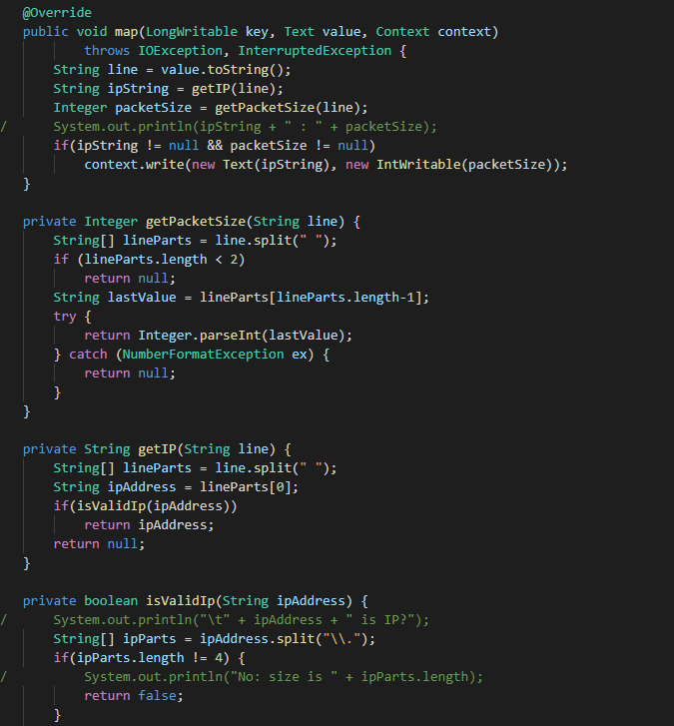
Average Mapper

Slide 8
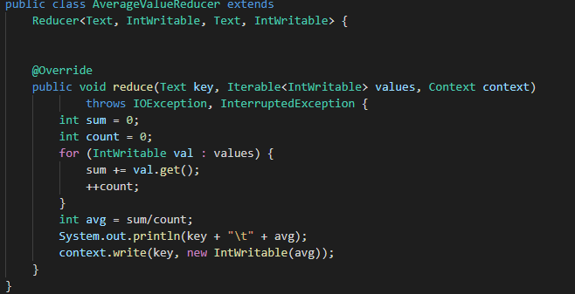
Average Reducer

Slide 9
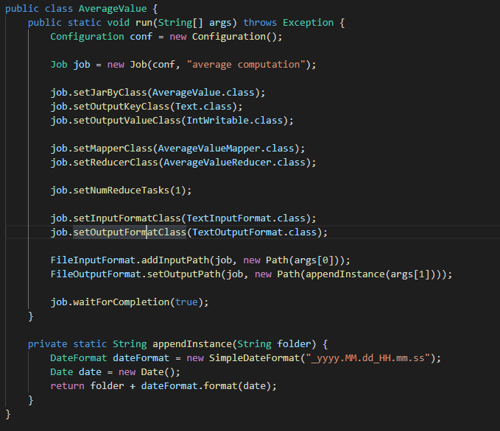
Average Main

Slide 10
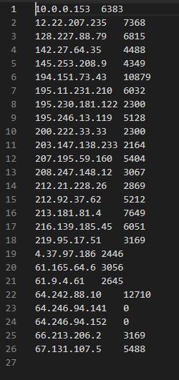
Average Output

Slide 11
In-Mapper Average

Slide 12
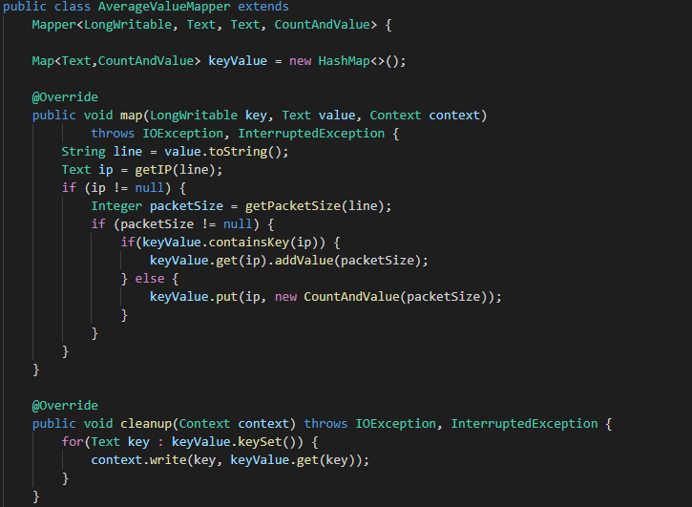
In-Mapper Average Mapper

Slide 13
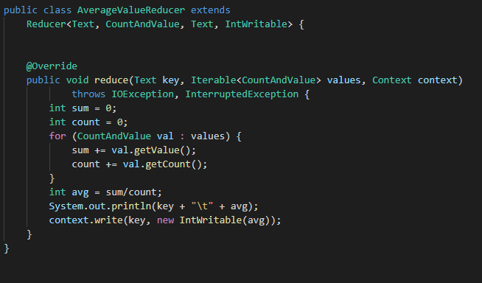
In-Mapper Average Reducer

Slide 14
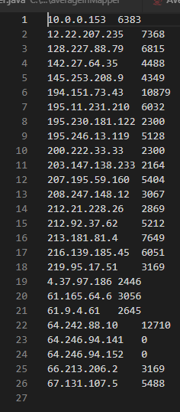
Average Output

Slide 15
Pair Approach

Slide 16
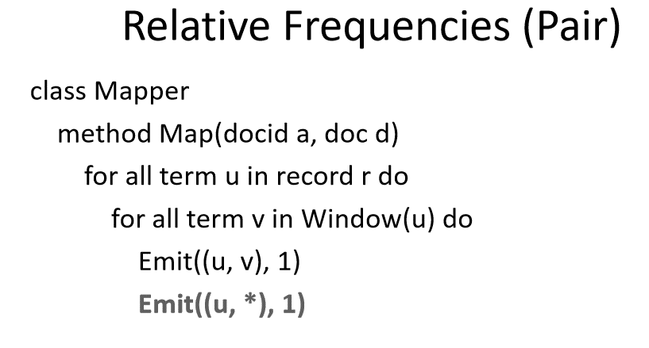
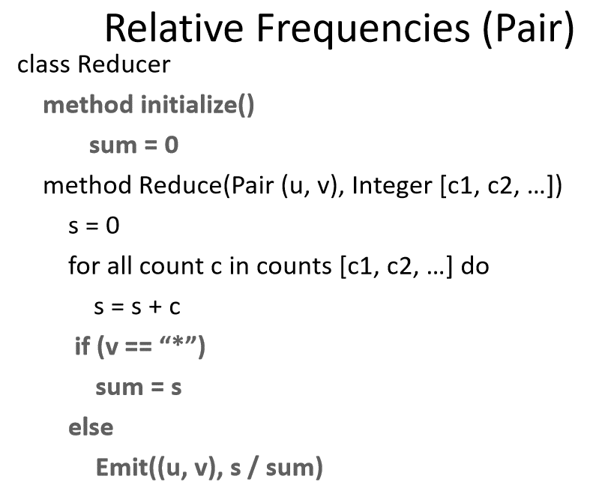
PAIR approach Pseudo-code

Slide 17
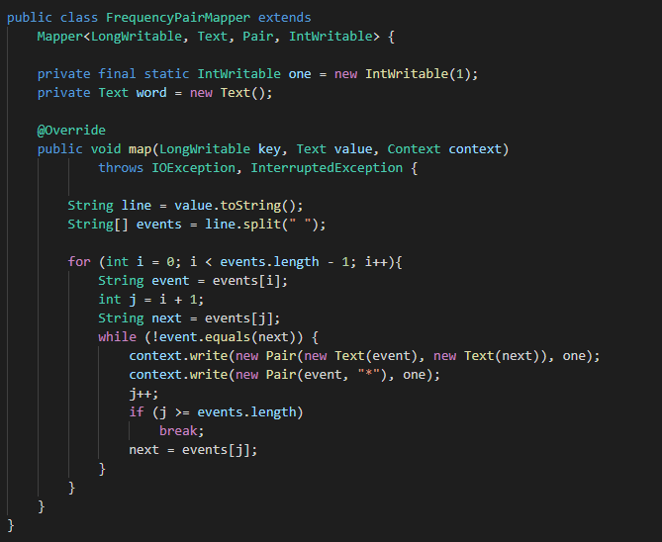
PAIR approach Mapper

Slide 18
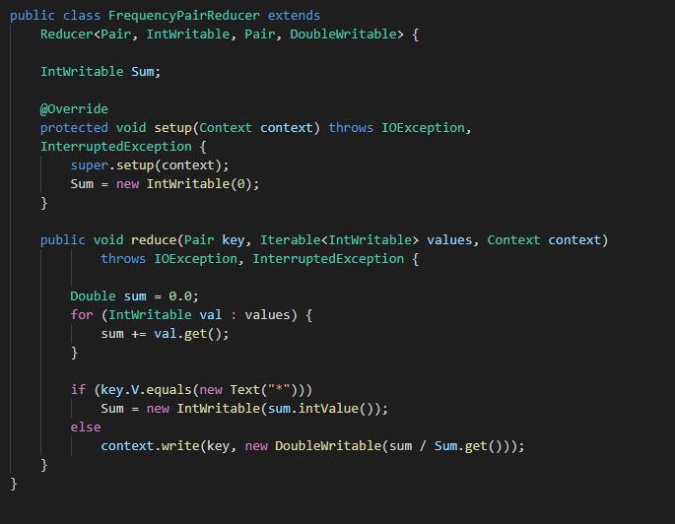
PAIR approach Reducer

Slide 19
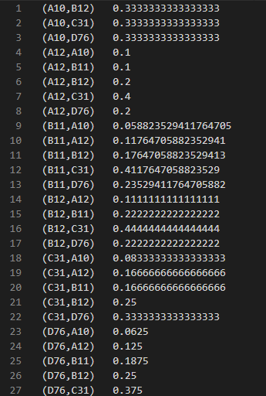
PAIR approach Output

Slide 20
Stripe Approach

Slide 21
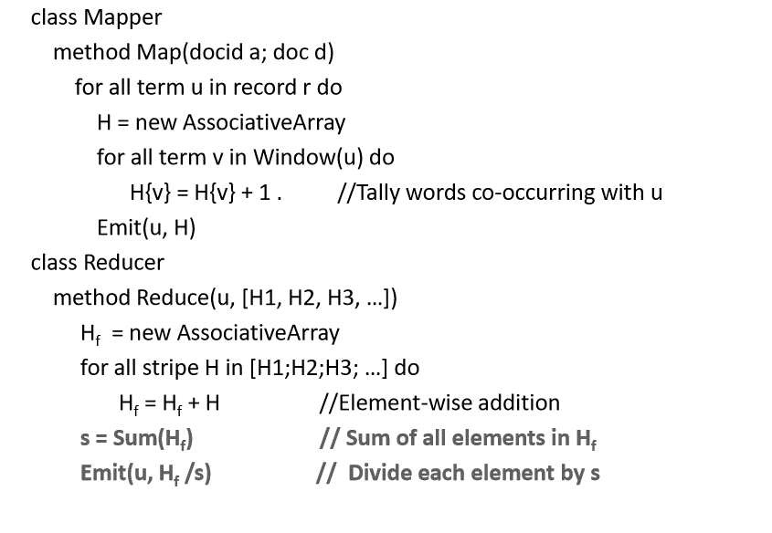
Stripe approach Pseudo-code

Slide 22
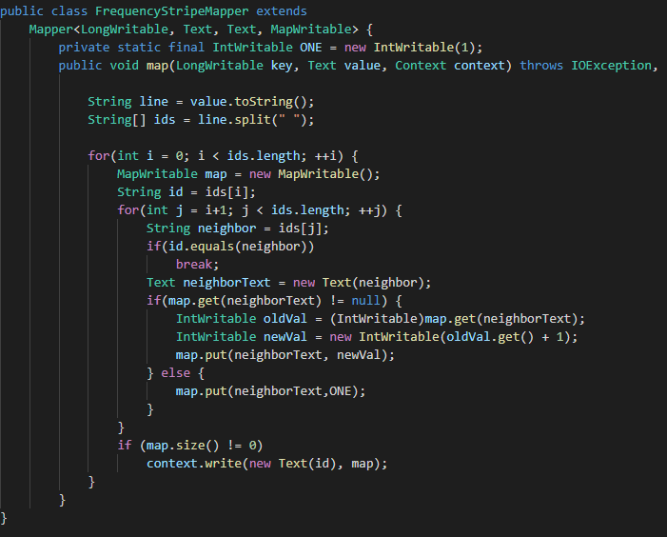
Stripe approach Mapper

Slide 23
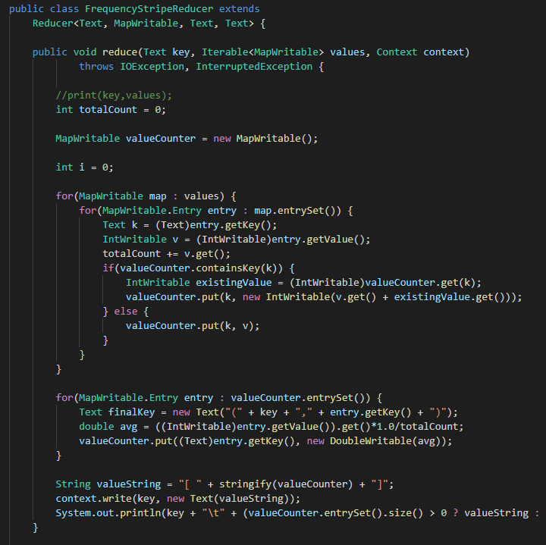
Stripe approach Reducer

Slide 24
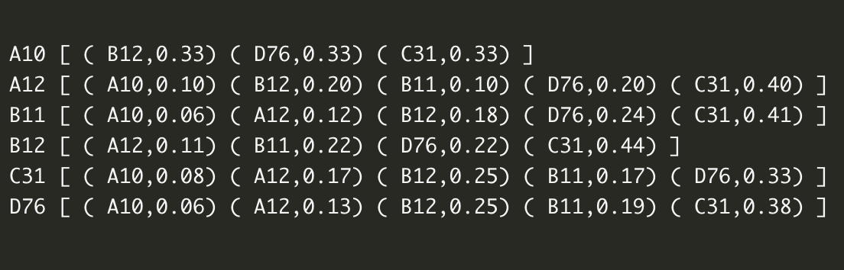
Stripe approach Output

Slide 25
Hybrid Approach

Slide 26
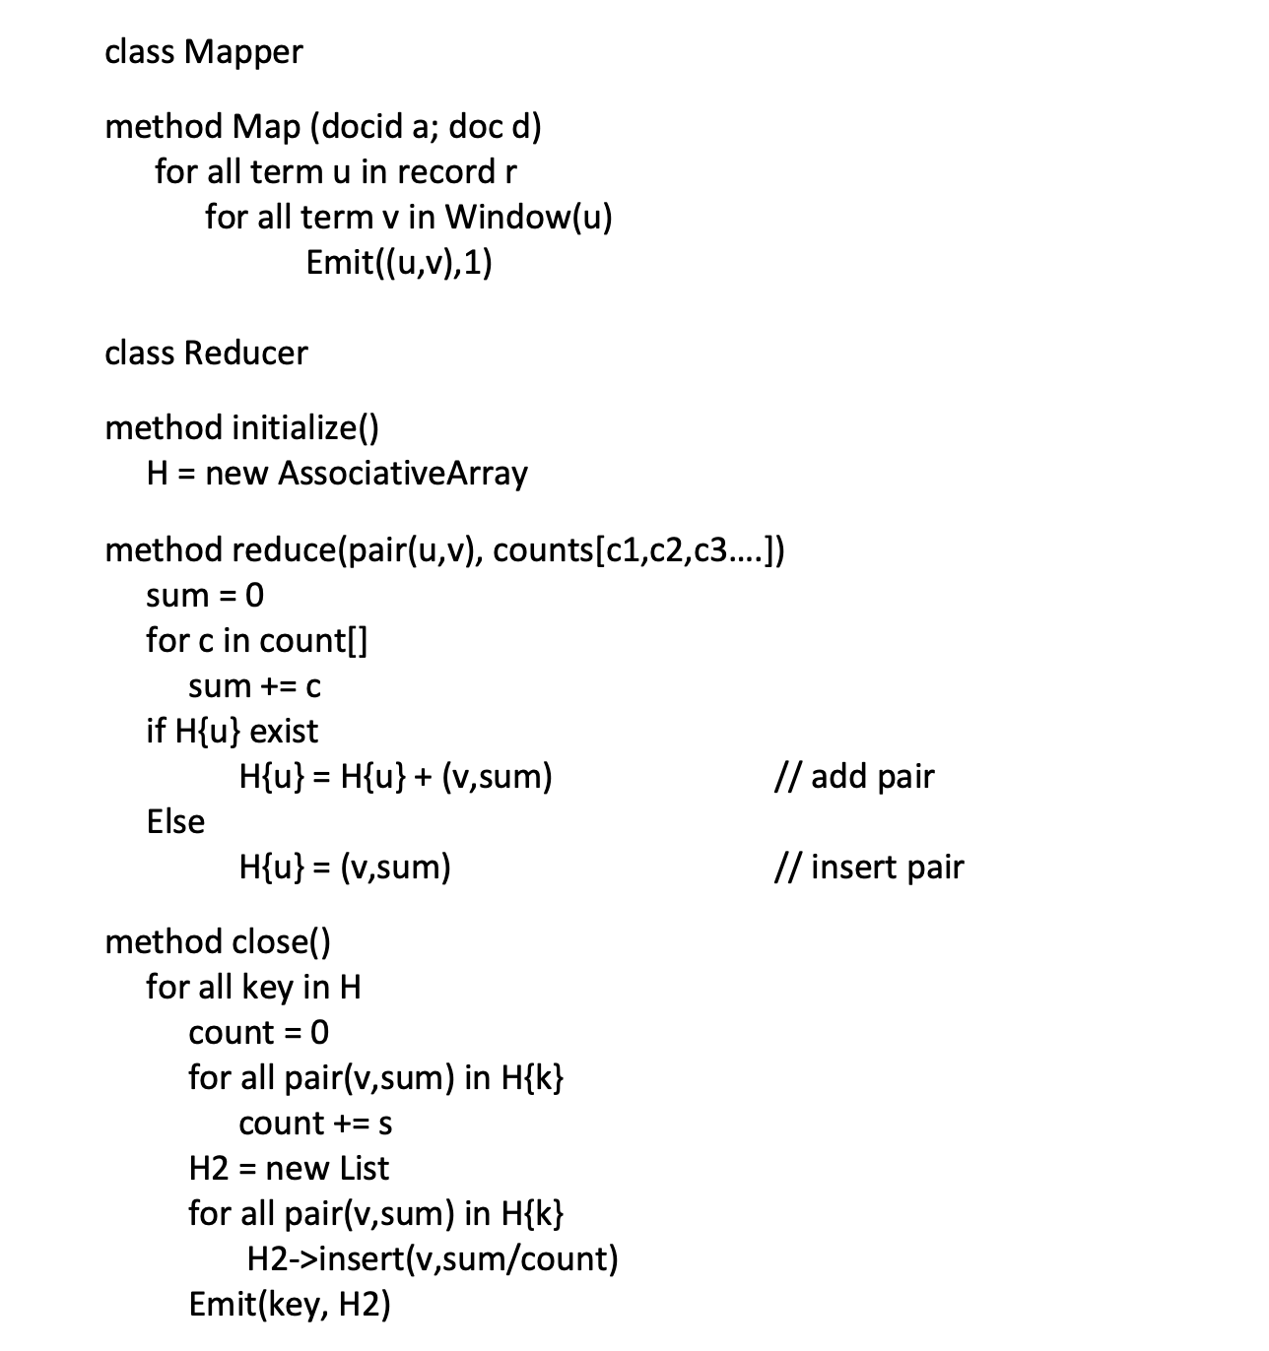
HYBRID approach Pseudo-code

Slide 27
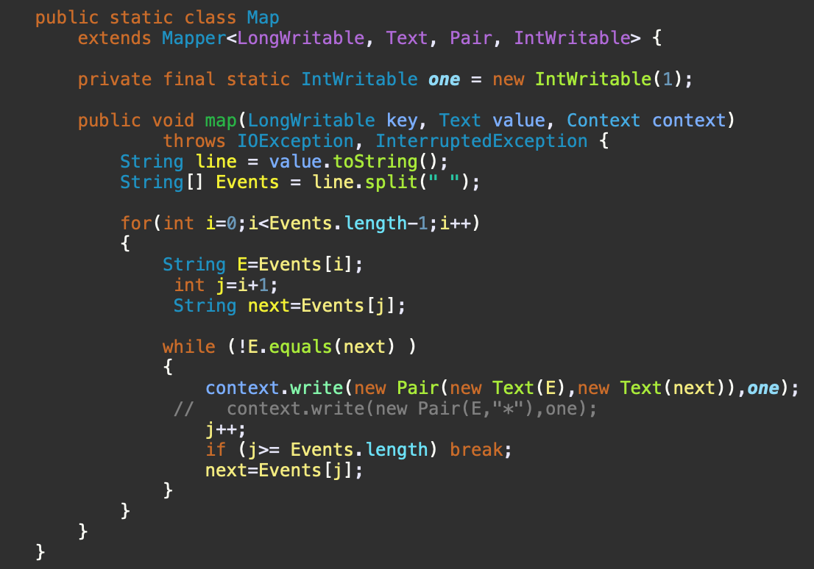
HYBRID approach Mapper

Slide 28
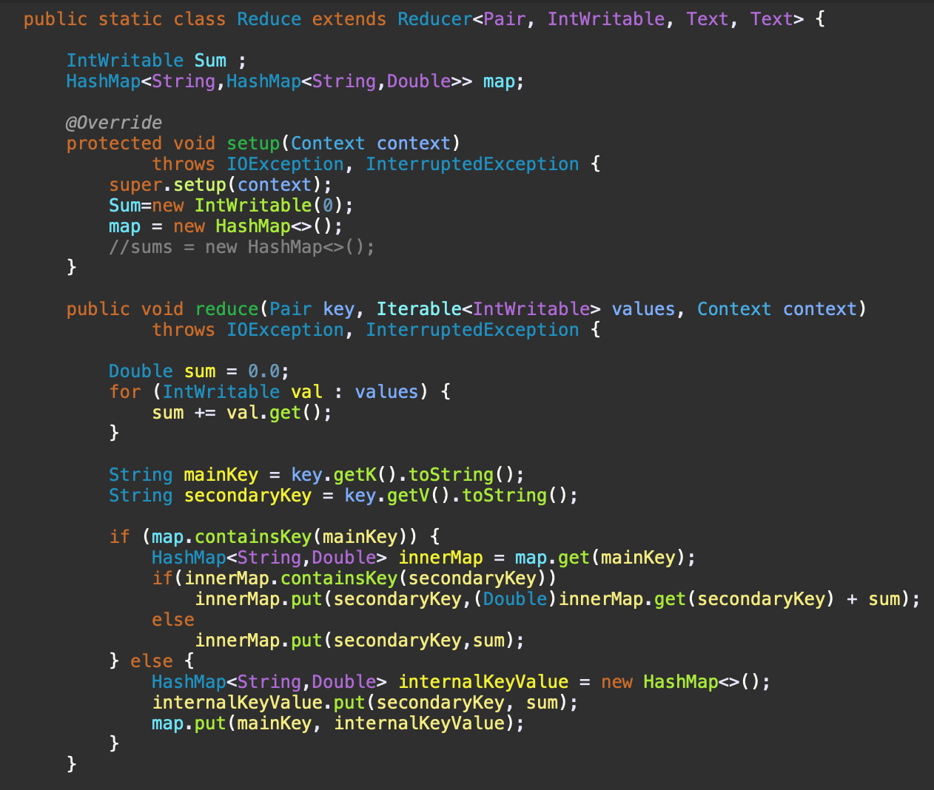
HYBRID approach Reducer

Slide 29
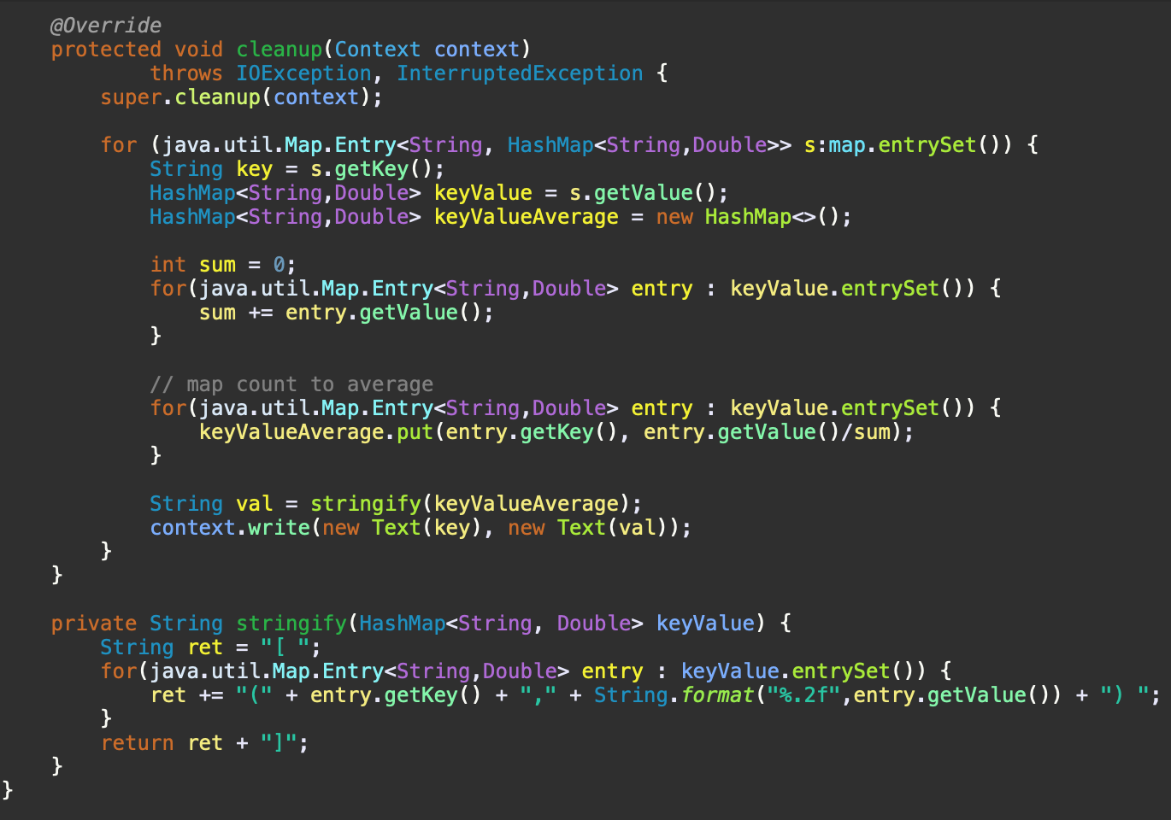
HYBRID approach Reducer

Slide 30
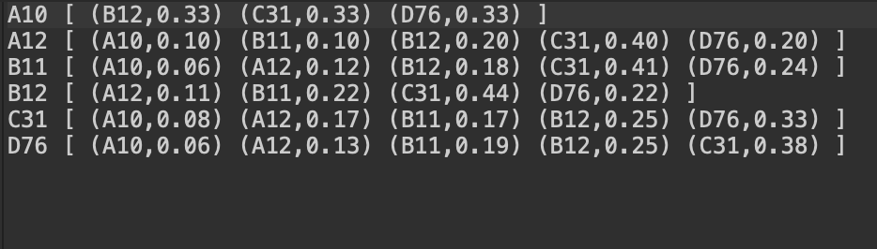
HYBRID approach Output

Slide 31
Time and Resource Comparison

Slide 32
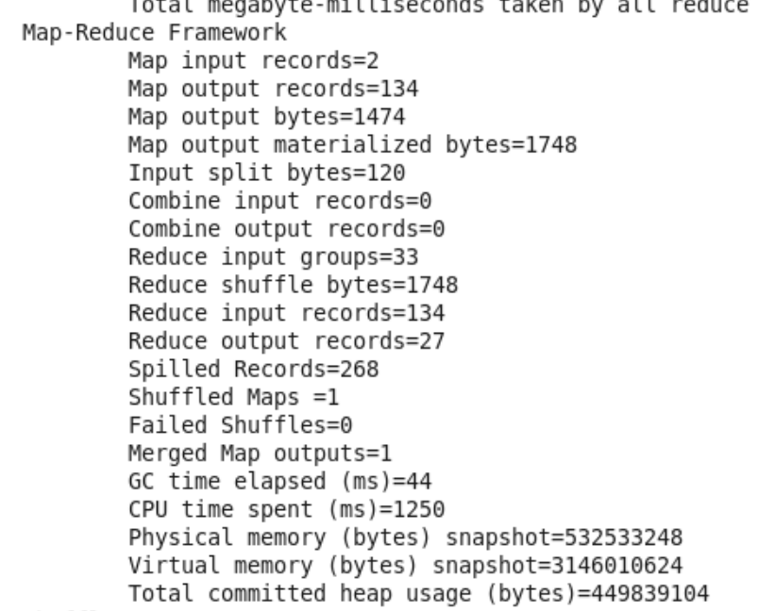
Pair Approach

Slide 33
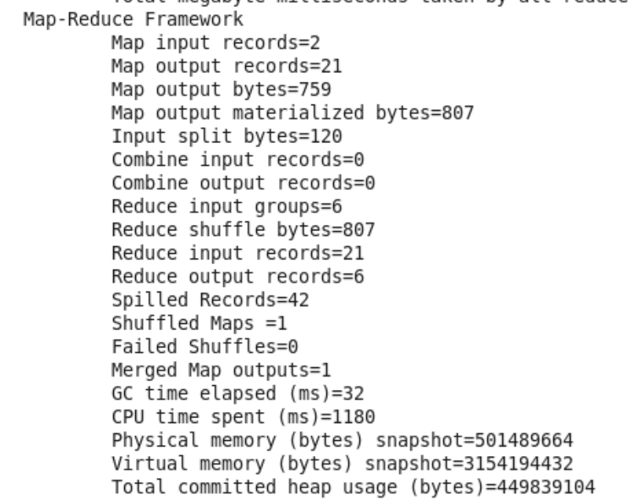
Stripe Approach

Slide 34
Hybrid Approach

Slide 35
Spark Project

Slide 36
Problem Statement
How does size of city affect the percentage of household income spent on food?
Data analyzed:
https://vincentarelbundock.github.io/Rdatasets/csv/Ecdat/BudgetFood.csv
Category chosen
town : the size of the Town where 1 is small town and 5 large town
Numerical value chosen
wfood : is the percentage of household income spent on food

Slide 37
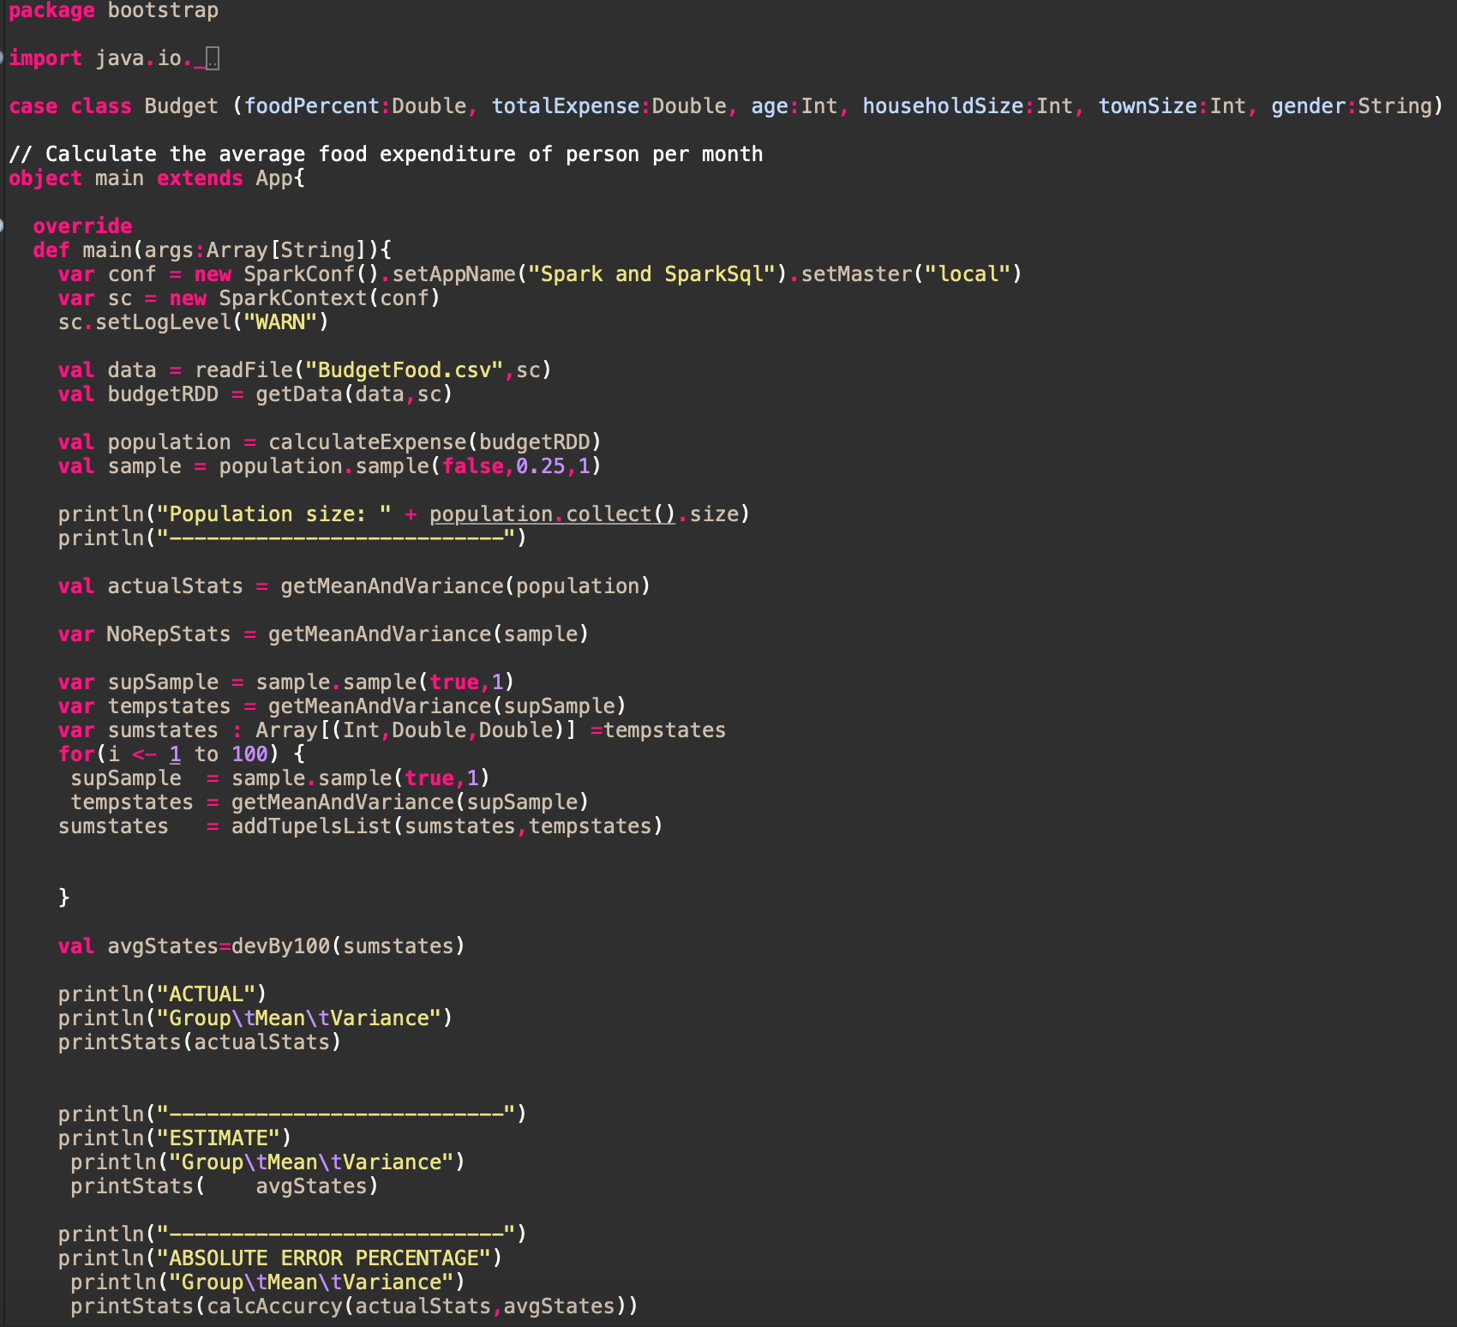
Scala Code

Slide 38
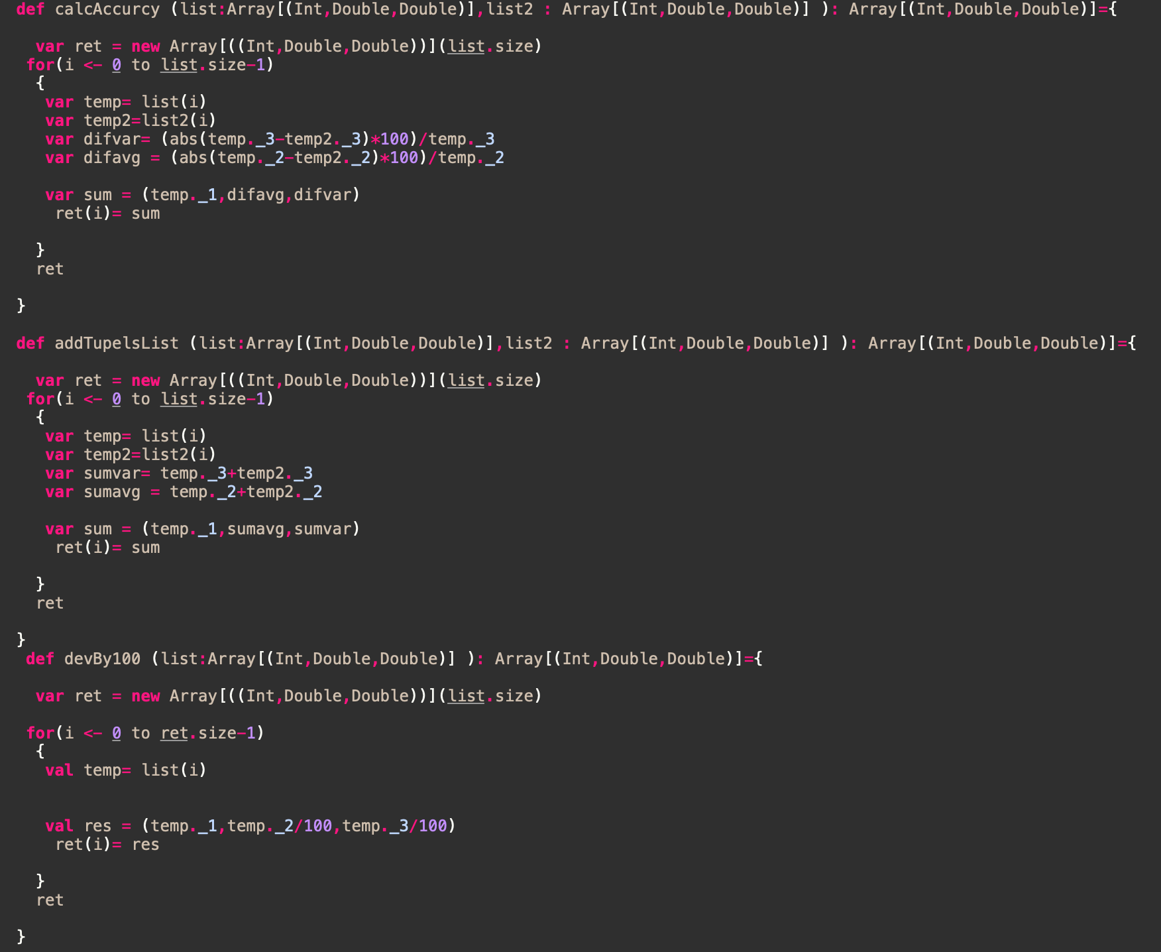
Scala Code

Slide 39
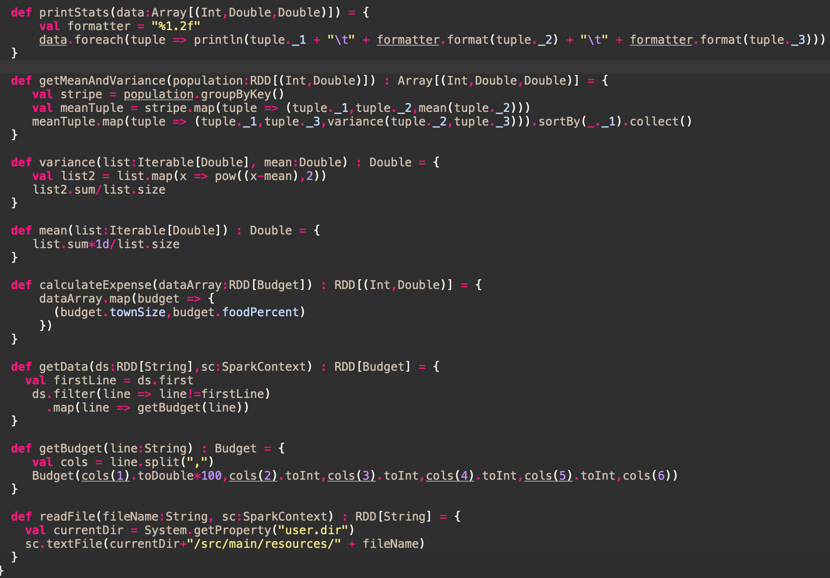
Scala Code

Slide 40
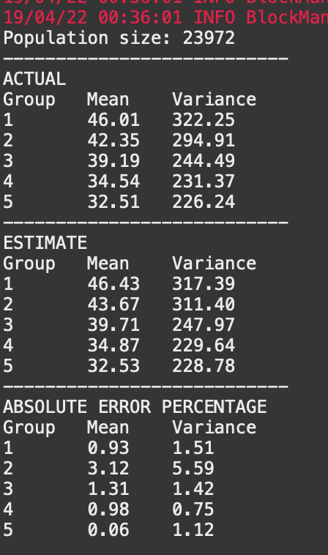
Output

Slide 41
Demo

Slide 42
Thank You

